Slide 1
Oracle Data Masking and Subsetting
Protect your sensitive data and reduce the risk of data breaches in non-production env
Hakim Loumi
Senior Principal Product Manager, Database Security

Slide 2
Three ways to tell the story
DMS - CEO
One slide, high level, focus on benefits
DMS - Short
Brief introduction to the benefits and use cases
DMS - Full
Describes the features and functionalities of Data Masking and Subsetting
Choose one of the three methods to tell the Oracle Data Masking and Subsetting story

Slide 3
CEO Level

Slide 4
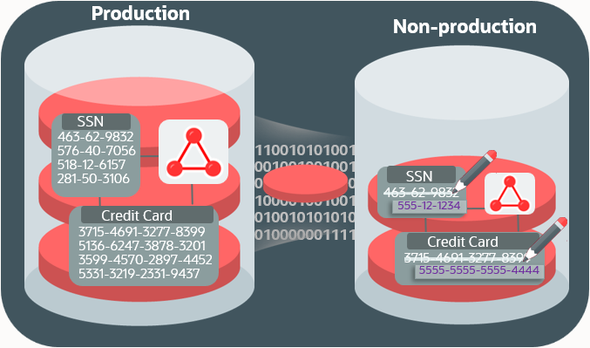
Oracle Data Masking and Subsetting
Minimize Risk, Maximize Value
Data Masking
Minimize sensitive data risk by removing sensitive data in test and development environments
Share data within and outside the organization without putting sensitive data at risk
No need to implement “Gold/Platinum” security controls on the masked data instances
Helps minimize compliance boundary and adhere to data privacy regulations (ex. GDPR “Recital 26”)
Enables data analytics for new insights and data monetization
Data Subsetting
Reduce the storage and operational costs
Minimize risk by sharing only the relevant and necessary data for non-production use
Easily process requests from government and law enforcements agencies
Integrate data subsetting with data masking to minimize risk and maximize value

Slide 5
Short Slides Deck

Slide 6








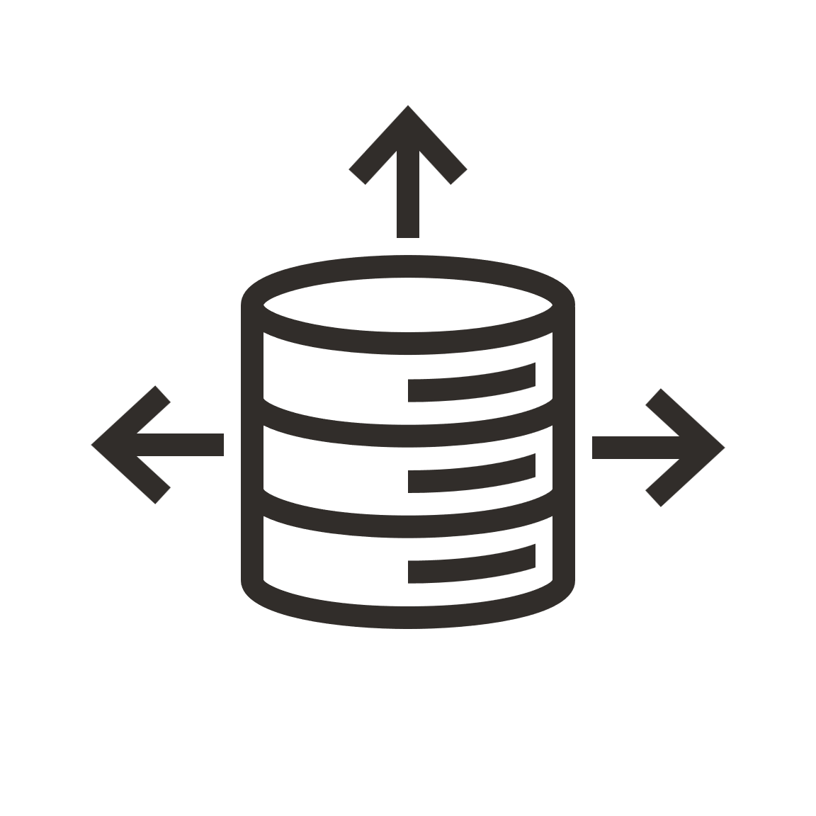

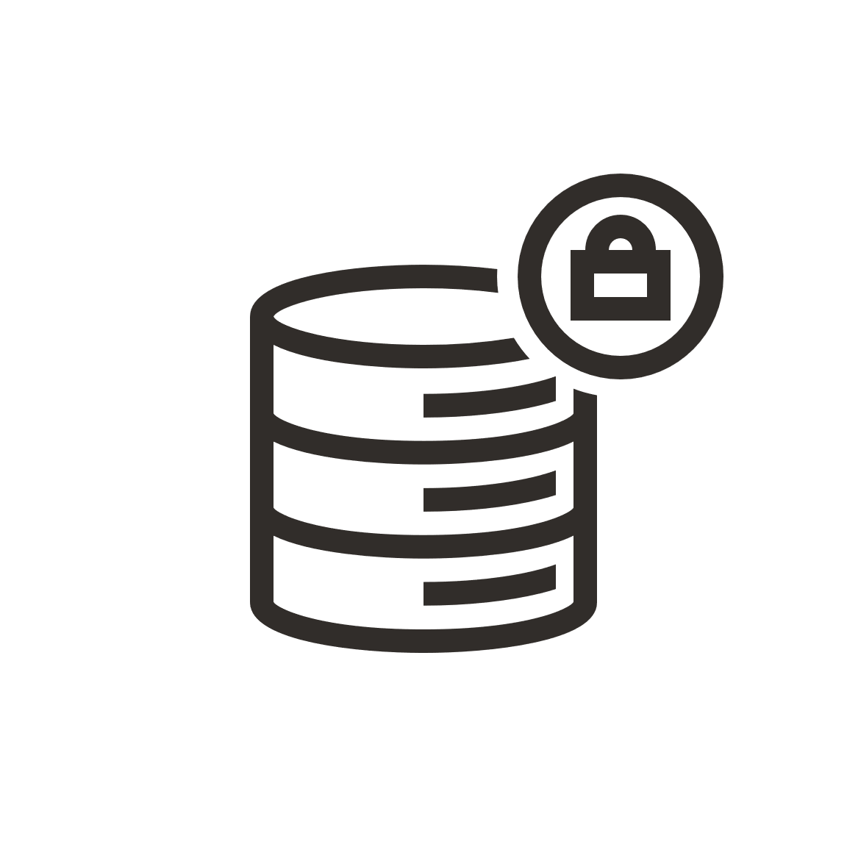

The problem
Proliferation of sensitive data increases security risk
Testing
Development
Cloud
Partners
Analytics
Demo
Training
Research
& More...
Notes:
And it’s not just a matter of this sensitive data being in a single pocket, stashed somewhere in the organization. Rather, the trend has been the proliferation of sensitive data through the entire organization. From the chart you can see various organizations that depend on data, many of which are not production groups, and which may not have good checks, balances, and processes to manage sensitive data.
Many organizations deal with sensitive data, whether it be PII, medical information, credit card (or other financial info), etc.
The security issues around sensitive data become amplified when databases that are meant for production use are provided as-is for Development, Test, Partners and even Training organizations.
You can imagine a database that is used for production and has access safeguards, privilege control , behavioral analysis, etc, has a very different risk footprint than the same database used in a non-production environment such as Dev or Test. Three out of four databases that exist in a corporation are for Dev or Test or some other non-production use. Yet many of them are complete copies of production data, which include all the sensitive data that we’ve been talking about.

Slide 7
Oracle Data Masking and Subsetting
Minimize Risk, Maximize Value

Slide 8





Data Masking
Benefits
Minimize sensitive data risk by removing sensitive data in test and development environments
Share data within and outside the organization without putting sensitive data at risk
No need to implement “Gold/Platinum” security controls on the masked data instances
Helps minimize compliance boundary and adhere to data privacy regulations (ex. GDPR “Recital 26”)
Enables data analytics for new insights and data monetization
Can keep test data around longer
Application Users
Secured Production Environment
Development & Test
Support & Partners
Masked Non-Production Copies
BI and Healthcare Analytics

Slide 9



Data Subsetting
Benefits
Minimize risk by sharing only the relevant and necessary data for non-production use
Reduce the storage and operational costs
Easily process requests from government and law enforcements agencies
Integrate data subsetting with data masking to minimize risk and maximize value
01001011001010100100100100100100100100100100
Subsetted
Data
Secured Production Environment
Consumers
of Data

Slide 10
Data Masking and Subsetting
Workflow
Create Data Model
Discover Sensitive Data
Discover Data Relationships
Select Formats & Criteria
Masking formats and templates
Goals & conditions for Subsetting
Preview & Validate
Preview masking algorithm results
Preview subset reduction results
Execute Transformation
In-database or In-Export
Rerun with same data model
2
4
1
3

Slide 11
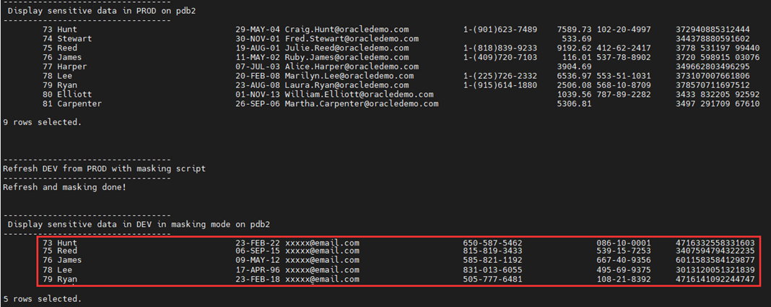
Data Masking and Subsetting
Protect and reduce the sensitive data

Slide 12
Unlimited Slides Deck

Slide 13
Conceptual Overview
Why do we need data masking?

Slide 14
The problem
Proliferation of sensitive data increases security risk
Testing
Development
Cloud
Partners
Analytics
Demo
Training
Research
& More...
Notes:
And it’s not just a matter of this sensitive data being in a single pocket, stashed somewhere in the organization. Rather, the trend has been the proliferation of sensitive data through the entire organization. From the chart you can see various organizations that depend on data, many of which are not production groups, and which may not have good checks, balances, and processes to manage sensitive data.
Many organizations deal with sensitive data, whether it be PII, medical information, credit card (or other financial info), etc.
The security issues around sensitive data become amplified when databases that are meant for production use are provided as-is for Development, Test, Partners and even Training organizations.
You can imagine a database that is used for production and has access safeguards, privilege control , behavioral analysis, etc, has a very different risk footprint than the same database used in a non-production environment such as Dev or Test. Three out of four databases that exist in a corporation are for Dev or Test or some other non-production use. Yet many of them are complete copies of production data, which include all the sensitive data that we’ve been talking about.

Slide 15
The challenges
How to Locate Sensitive Data at short and long term?
In the midst of numerous applications, databases, and environments
How to Accurately Protect Sensitive Data?
Data has different shapes and forms: VISA, AMEX, Discoverer, Master, SSN, and more
Is the Protected Data Usable?
To developers, testers, applications, and more
Will the Applications Continue to Work?
To develop and maintain such solution in this ever-changing IT landscape (On-premises and Cloud)
Limit Sensitive Data Proliferation
Test, Dev, QA, Training, Research, Outsourced, Cloud, and more
Save Storage Costs
Non-Prod such as Test/Dev, Mega Data warehouses, and more
Share What is Necessary
With Subscribers, auditors, courts, partners, testers, developers, and more
Right to be Forgotten/Erasure (GDPR in Europe)

Slide 16
A world of regulation
NCUA
PIPEDA
FOIPPA
FS-ISAC
Ru DPA
HIPAA
CIP
EU GDPR
CCPA
FFIEC
Cn GDPL
Jp APPI
50 State Data Privacy Laws
Patriot Act
GLBA
NY DFS500
Ma DPA
In PDPB
Hk PDPO
BASEL III
Dodd Frank
Mx PDPL
PCI
Th PDA
Si PDPA
Co DPL
Br GDPL
Sa ECTA
Au APP
Cl PPL
Nz PA
Ar PDPL

Slide 17




The constraints
Compliance regulations mandate sensitive data protection
PCI DSS 4.0
6.4.3 Production data (live PANs) are not be used for testing or development purposes.
EU General Data Protection Regulation
The application of pseudonymisation to personal data can reduce the risks for the data subjects concerned and help controllers and processors meet their data protection obligations
The Health Insurance Portability and Accountability Act of 1996
The removal of specified identifiers of the individual and of the individual’s relatives, household members, and employers is required
… and more

Slide 18


Data Masking Concepts
Dynamic or Static Data Masking
Dynamic Data Masking
Masks sensitive data on the fly based on access rules, leaving the data in the database as is
Static Data Masking
Masks sensitive data by permanently replacing it with fictitious but realistic data

Slide 19
Data Masking Concepts
Dynamic or Static Data Masking
 | Dynamic Data Masking | Static Data Masking
Benefits | Helps enforce need-to-know principle and minimize unnecessary exposure of sensitive data to application users Application end users see the masking data only (but users with direct access to data can still see the original sensitive data) | Enables sharing of data for non-production use such as development and analytics without putting sensitive data at risk No one, including DBAs, can see the sensitive data in masked copies as it has been replaced permanently
Oracle technologies | Oracle Data Redaction | Oracle Data Masking and Subsetting Oracle Data Safe

Slide 20
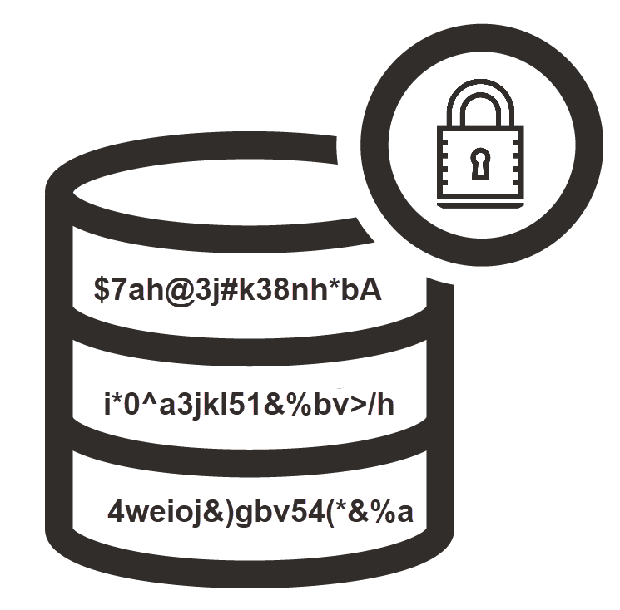
Static Data Masking solutions
Why do I need data masking when I already encrypt my data?
 | Static Data Masking | Encryption
Concept | Masks sensitive data by permanently replacing it with fictitious but realistic data | Encrypts/hides the plaintext using an encryption algorithm rendering it unintelligible for unauthorized people
Accessing data | Original data can’t be retrieved or accessed (unless using a reversible masking technique) | Original data can be retrieved with appropriate access or encryption key
Benefits | Non-production users can access the data for development and analytics, but can’t see the sensitive data | Unauthorized people can’t access the data (but authorized users can see the sensitive data even in non-production environments)

Slide 21
Oracle Data Masking
What is it exactly?

Slide 22
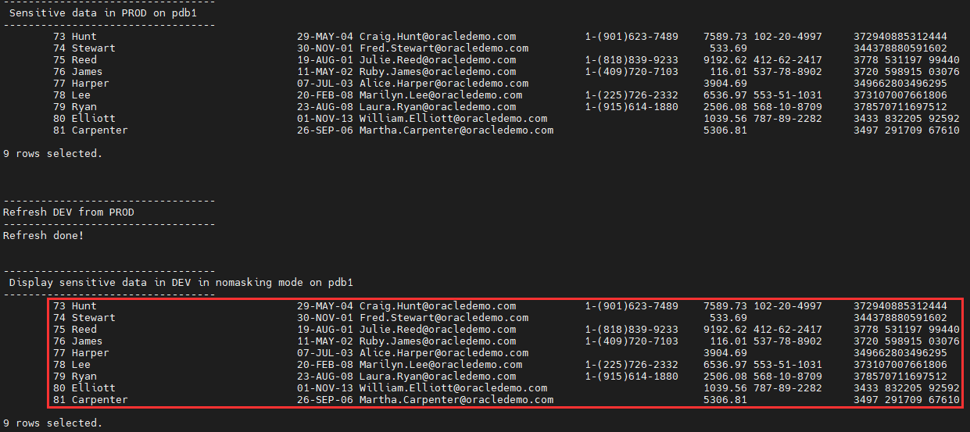
Refreshing data in non-Prod database
Sensitive data is duplicated

Slide 23
Data Masking and Subsetting
Protect and reduce the sensitive data

Slide 24







Oracle Data Masking and Subsetting
Minimize Risk, Maximize Value
Production
Discover sensitive data
Non-production
Mask data using format library
SSN
463-62-9832
576-40-7056
518-12-6157
281-50-3106
Subset based on goal/condition
0100101100101010010010010010010010010010010010001001010100100100100111001001001001001001000010010010111001001010100100101010100110101001010100100000011111111000
SSN
463-62-9832
Execute in-database or during export
Credit Card
3715-4691-3277-8399
5136-6247-3878-3201
3599-4570-2897-4452
5331-3219-2331-9437
555-12-1234
Mask in workload captures & clones
Credit Card
3715-4691-3277-8399
5555-5555-5555-4444
Support non-Oracle and cloud DBs
Pre-installed in Enterprise Manager

Slide 25
Static Data Masking solutions
Benefits
Better data leads to more efficient test and development cycles
Share data within and outside the organization without putting sensitive data at risk
No need to implement “Gold/Platinum” security controls on the masked data instances
Helps minimize compliance boundary and adhere to data privacy regulations (ex. GDPR “Recital 26”)
Enables data analytics for new insights and data monetization
Can keep test data around longer
Application Users
Secured Production Environment
Development & Test
Support & Partners
Masked Non-Production Copies
BI and Healthcare Analytics

Slide 26
Data Subsetting
Benefits
Minimize risk by sharing only the relevant and necessary data for non-production use
Reduce the storage and operational costs
Easily process requests from government and law enforcements agencies
Integrate data subsetting with data masking to minimize risk and maximize value
01001011001010100100100100100100100100100100
Subsetted
Data
Secured Production Environment
Consumers
of Data

Slide 27




Oracle Data Masking and Subsetting
Deployment Options
In- Database
In- Export
010010110010101001001001001001001001001001001000100101010010
010010110010101001001001001001001001001001001000100101010010
010010110010101001001001001001001001001001001000100101010010010010011100100100100100100100001001001011100100101010010
SOURCE
Staging
TARGET
SOURCE
Export
TARGET
Minimal impact on the source environment
Sensitive data remains within the source perimeter
Heterogenous
Oracle Only

Slide 28



Oracle Data Masking and Subsetting
Mask/subset on-premises and upload to the cloud
In-DB to Cloud
In-Export to Cloud
Clone > Mask/Subset > Upload
Extract > Mask/Subset > Upload
Target
Target
010010110010101001001001001001001001001001001000100101010010
010010110010101001001001001001001001001001001000100101010010
010010110010101001001001001001001001001001001000100101010010
010010110010101001001001001001001001001001001000100101010010
Staging
Export File
Source
Source
On-premises
On-premises

Slide 29




Oracle Data Masking and Subsetting
Mask/subset on the wire or in the cloud
Clone to Cloud
In-Cloud
Clone & mask PDB to cloud
Mask/subset in the cloud
010010110010101001001001001001001001001001001000100101010010
010010110010101001001001001001001001001001001000100101010010
On Premises
On Premises

Slide 30
Oracle Data Masking and Subsetting
In Oracle Data Guard Environment
Physical Standby
Snapshot Standby
Primary
Convert Physical to Snapshot Standby
1
2
Define
Mask/Subset
010010110010101001001
010010110010101001001001001001001001001001001000100101010010010010011100100100100100100100001001
3
Generate & Export Mask /Subset
5
Convert Snapshot to Physical Standby
4
Import mask/subset data dump
Test/Dev

Slide 31

Oracle Data Masking and Subsetting
Thin Provisioning Using Oracle Cloud Management Pack’s Snap Clone
Snap Clone
Replicate > Mask/Subset > Copy
010010110010101001001
110010010010010010010010010
Prod
Standby
Test Master
Functional Copies
User can create copies for functional testing within minutes without consuming space

Slide 32
Oracle Data Masking and Subsetting
In Oracle Golden Gate Environment
2
Stop Replication
Target
Source
1
Define
Mask/Subset
Oracle Golden Gate Replication
010010110010101001001001001001001001001001001000100101010010010010011100100100100100100100001001001011100100101010010010101010011010100
3
Generate & Execute Mask /Subset
5
Start Replication
4
Import mask/subset data dump
Test/Dev

Slide 33
Oracle Data Masking and Subsetting
With Oracle Data Integrator (ODI)
ODI
ODI
010010110010101001001001001001001001001001001000100101010010
010010110010101001001001001001001001001001001000100101010010
SOURCE
Heterogenous
Staging
(Oracle DB)
TARGET
Heterogeneous

Slide 34

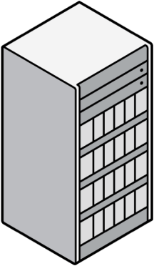



Oracle Data Masking and Subsetting
Masking in Oracle Fusion SaaS
Production
Dev/Test
1
Customer requests to mask sensitive data in test/dev
010010110010101001001001001001001001001001001000100101010010
Oracle Managed Cloud Services team masks the sensitive data using automated procedures
2

Slide 35
How does it work?
Workflow

Slide 36
Static Data Masking solutions
Workflow
Create Data Model
Discover Sensitive Data
Discover Data Relationships
Select Formats & Criteria
Masking formats and templates
Goals & conditions for Subsetting
Preview & Validate
Preview masking algorithm results
Preview subset reduction results
Execute Transformation
In-database or In-Export
Rerun with same data model
2
4
1
3

Slide 37




Oracle Data Masking and Subsetting
Application Data Modeling
Data
Subsetting
Data
Encryption
Database Defined
Relations
Data
Masking
Database
Vault
Data
Governance
Referential Relationships
Consumed by
Application Defined
Relations
Sensitive Columns
Data
Redaction
Audit
Vault
Automated Discovery

Slide 38
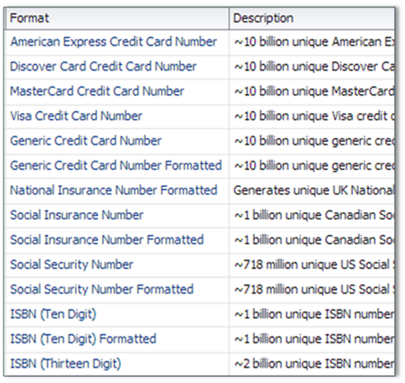
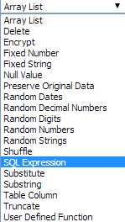
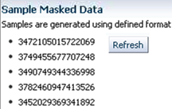
Oracle Data Masking and Subsetting
Data Masking
Leverages application data model to
Replace sensitive data with realistic, fictitious data
Preserve referential integrity
Provides comprehensive, extensible, and flexible masking options
Predefined masking formats to mask common data
User-defined formats to meet domain-specific requirements
Masking transformations to implement diverse business use cases
Conditional, compound, unique, reversible, deterministic, format preserving
Sample masked data for validation
Masking templates for EBS and FA

Slide 39
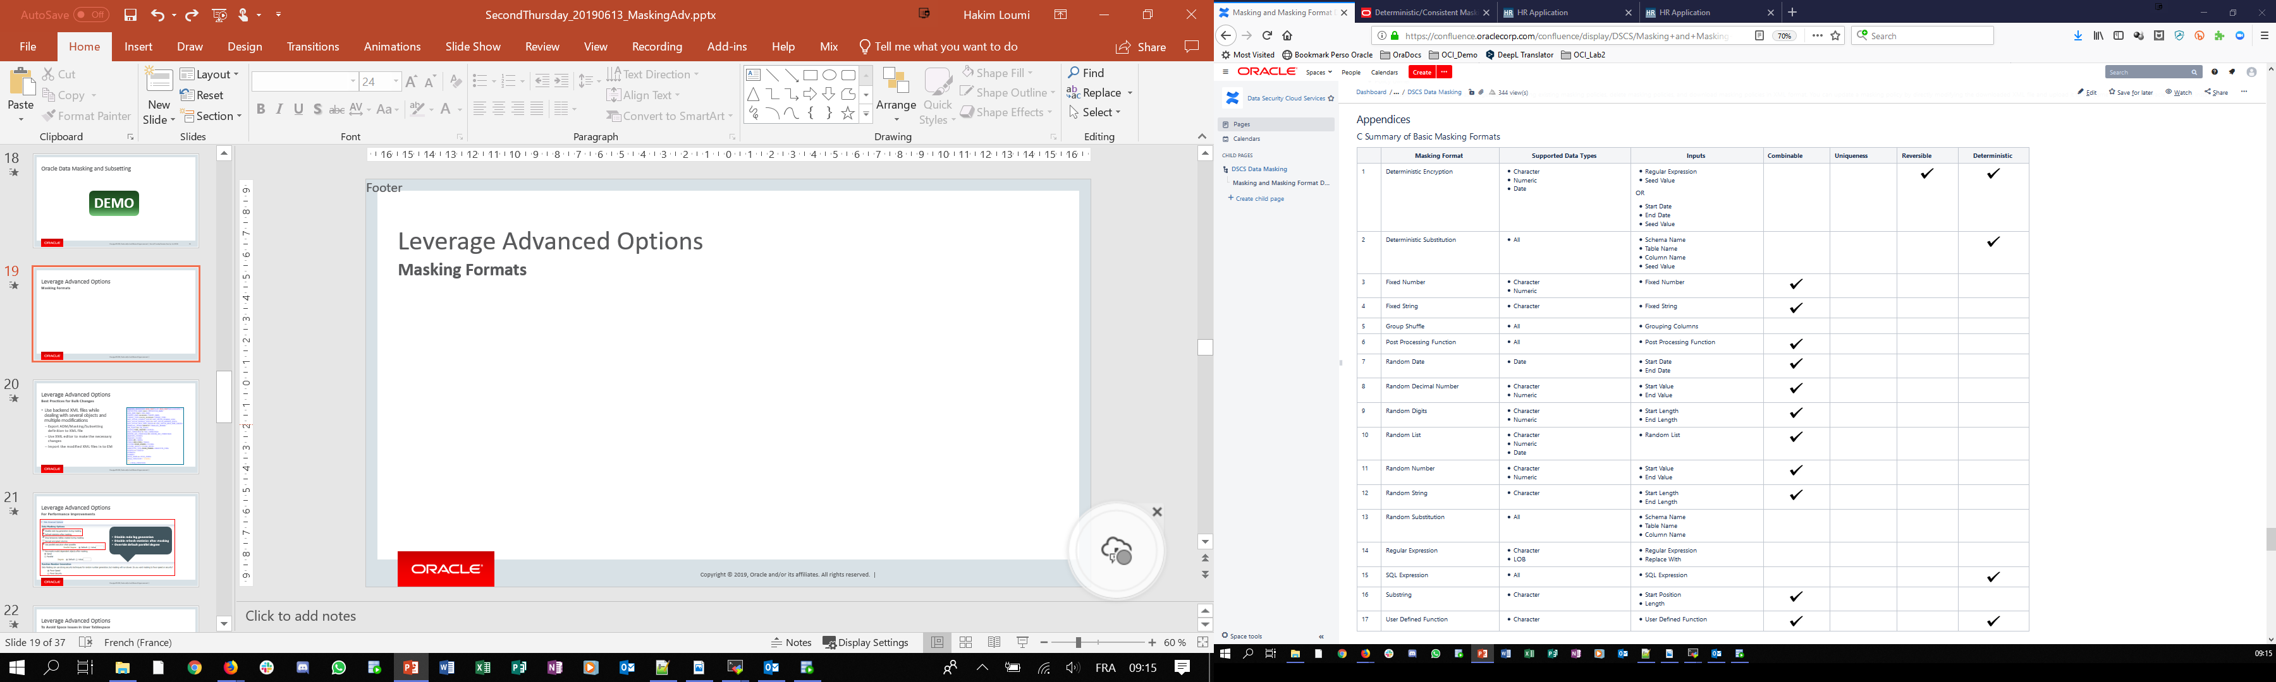
Oracle DMS Demo Tips
Leverage Masking Algorythms

Slide 40
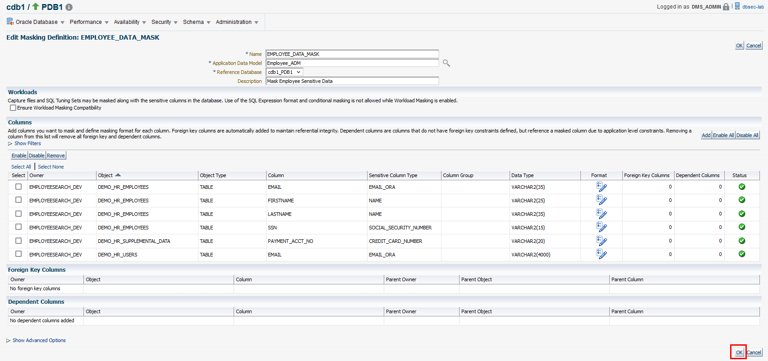
Oracle Data Masking and Subsetting
Masking Script
Notes:
Conditional transformation provides an ability to arrange masking formats according to different conditions.
For example, consider masking a column containing unique identifiers.
Identifiers that belong to IT_PROD can be masked using specific value format and that belong to ST_CLERK can be masked using another one.

Slide 41
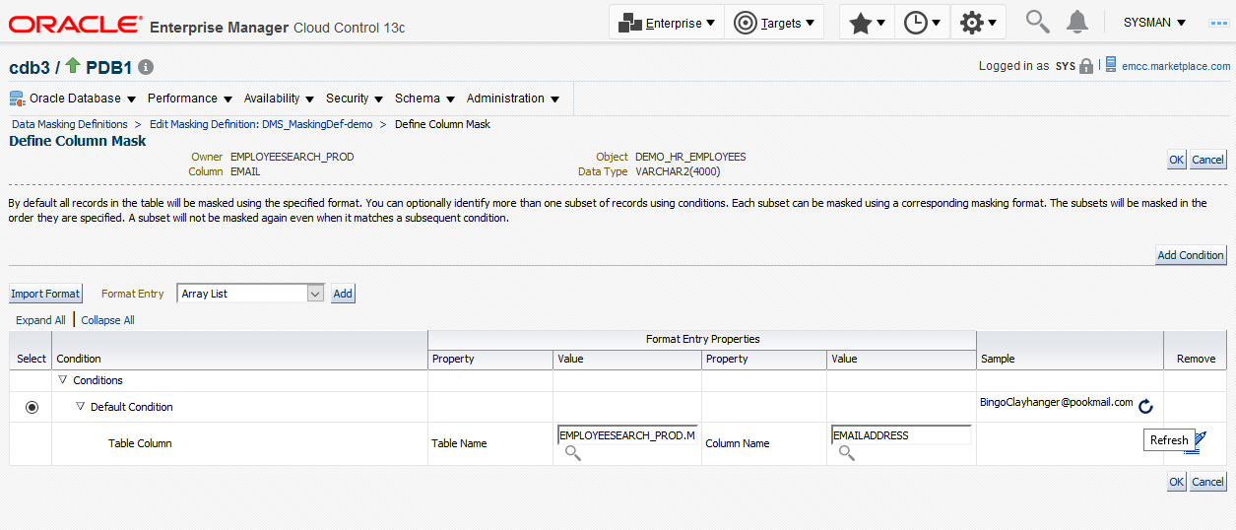
Oracle Data Masking and Subsetting
Preview and Validate Masking Results

Slide 42
Demo
Oracle Data Masking and Subsetting

Slide 43
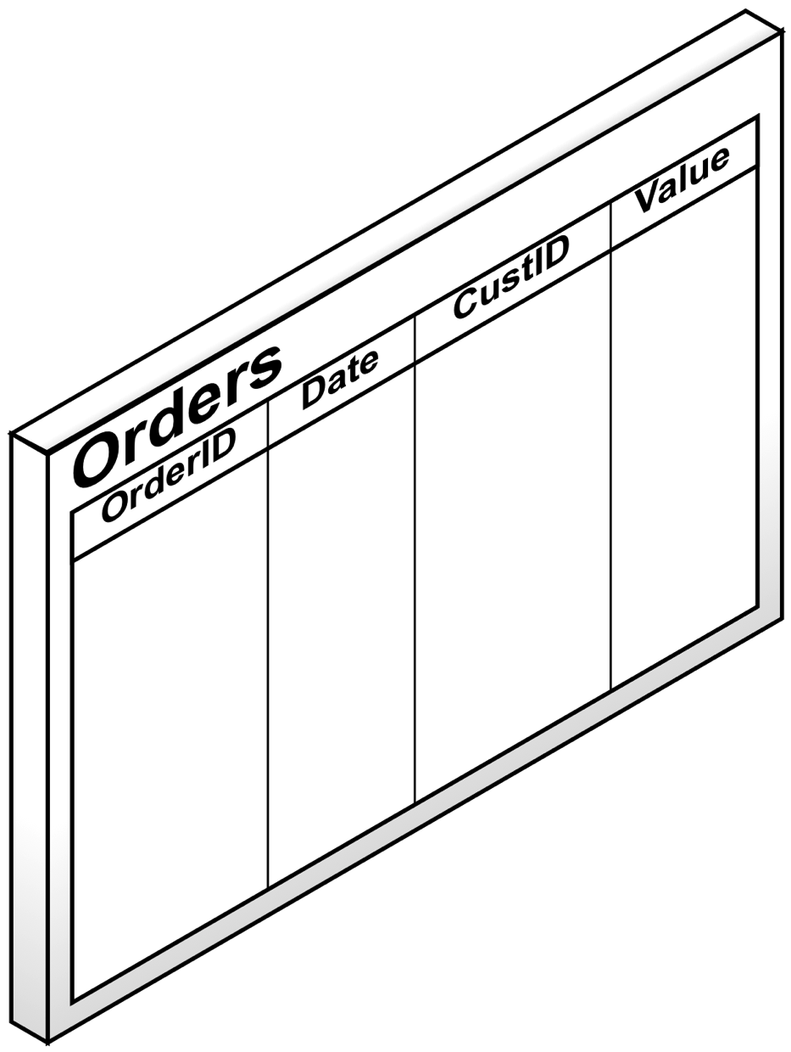


Oracle Data Masking and Subsetting
Data Subsetting
Relative Table Size
Leverages application data model to
Extract subset of data or remove unnecessary data
Preserve referential integrity
Supports various subsetting use cases such as
Extracting a fraction of a large table
Fetching data from a particular region for analytics
Extracting rows belonging to a particular partition or sub-partition of a table
Integrates with Data Masking enabling you to
Subset Prod data and then mask sensitive data in this subset
Maximize the business value of production data without compromising sensitive data or wasting resources
100M Rows
20M Rows
2M Rows
Condition Based
0100101100101010010010010010010010010010010010001001010100101010101010
ASIA
ASIA Sales
Table Partitions
JAN
JAN
SALES
SALES
FEB
FEB
EMEA
APAC

Slide 44
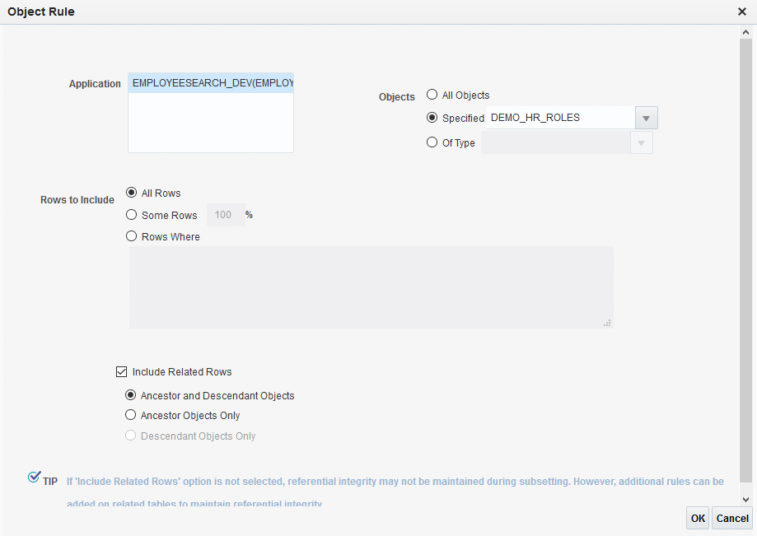
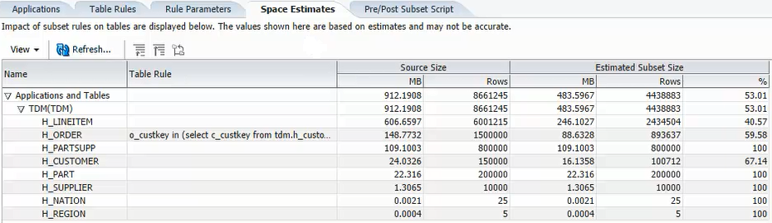
Oracle Data Masking and Subsetting
Subsetting script

Slide 45
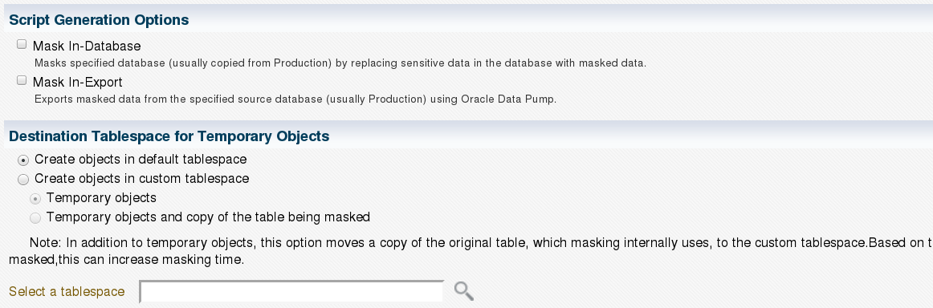
Oracle Data Masking and Subsetting
Generating scripts

Slide 46
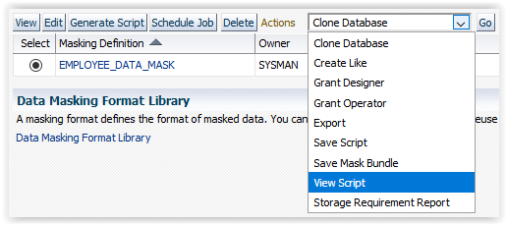
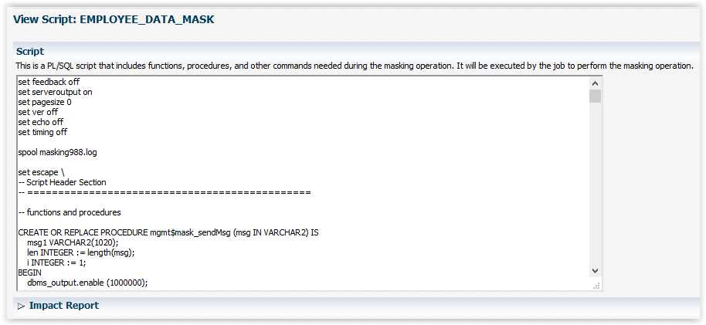
Oracle Data Masking and Subsetting
Generating scripts
Notes:
Conditional transformation provides an ability to arrange masking formats according to different conditions.
For example, consider masking a column containing unique identifiers.
Identifiers that belong to IT_PROD can be masked using specific value format and that belong to ST_CLERK can be masked using another one.

Slide 47
Advanced Features

Slide 48
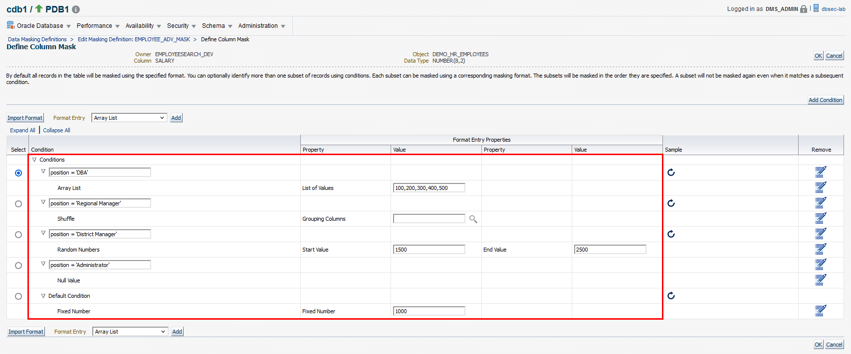
Oracle Data Masking and Subsetting
Advanced Options - Conditional Masking
Add conditions to mask sensitive data differently regarding a specific parameter
Notes:
Conditional transformation provides an ability to arrange masking formats according to different conditions.
For example, consider masking a column containing unique identifiers.
Identifiers that belong to IT_PROD can be masked using specific value format and that belong to ST_CLERK can be masked using another one.

Slide 49
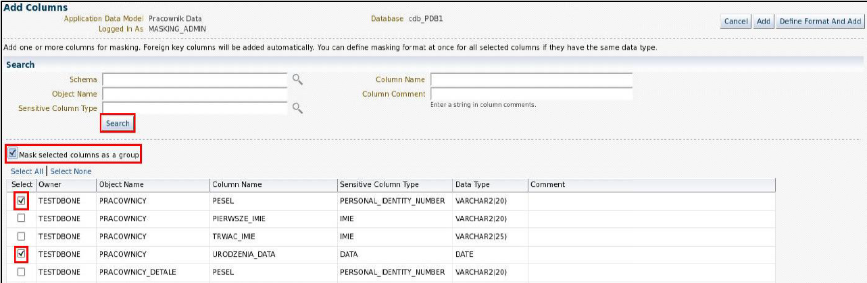
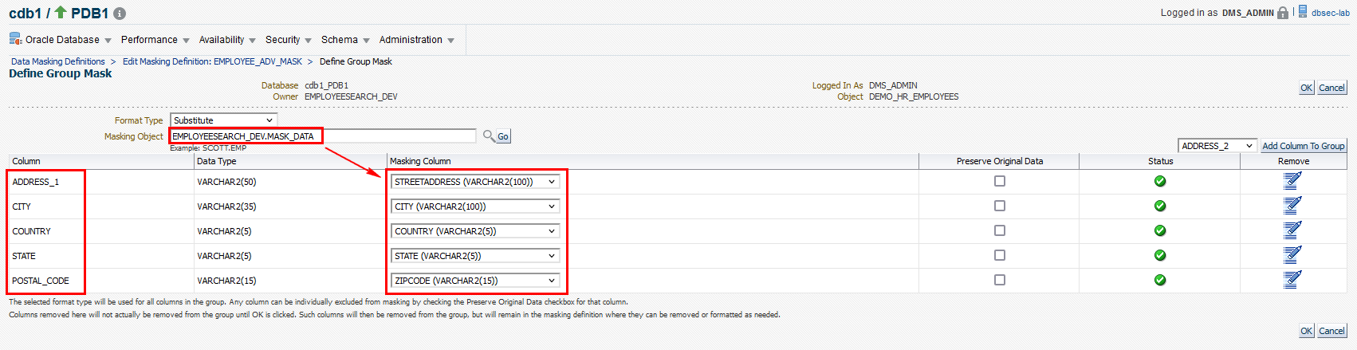
Oracle Data Masking and Subsetting
Advanced Options - Compound Masking
It is possible to select Mask selected columns as a group : this process is known as compound masking
It allows columns to be associated together for the masking process, so the masked data appears consistent
Notes:
Compound masking, also known as grouping option, enables you to mask related columns together as a group, ensuring that the masked data across the related columns retain the same relationship.
The columns being masked as a group must belong to the same table.
You can use Deterministic Substitution, Random Substitution, Shuffle, or User Defined Function for compound masking.

Slide 50
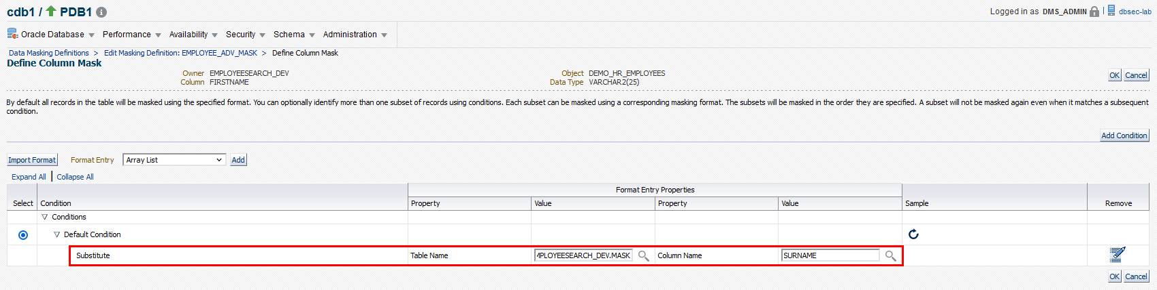
Oracle Data Masking and Subsetting
Advanced Options - Deterministic Masking
This technique ensures repeatable masked values after a mask run
Enterprise may use this technique to ensure that certain values, e.g. a customer number gets masked to the same value across all databases.
Notes:
One of the key requirements while masking data in large databases or multi-database environment is to consistently mask some columns, i.e., for a given input, the output should always be the same. At the same time, the masked output should not be predictable.
Deterministic masking generates consistent output for a given input across databases and data masking jobs.
Masking multiple times across different databases yields the same masked value.
This characteristic is valid across multiple databases or multiple runs assuming that the same input values are used in the two runs.
Deterministic masking is helpful in maintaining data integrity across multiples applications and preserve system integrity.
Note for Substitute : the method uses a hash-based algorithm in the back end, the mappings are consistent.
that the uniqueness of the masked value is not guaranteed but depends on the number of columns being used in the substitution table i.e. if the original table contains 50000 unique values, then for the masked output to be unique and deterministic the substitution column should also contain 50000 unique values without which only consistency is maintained but not uniqueness.

Slide 51
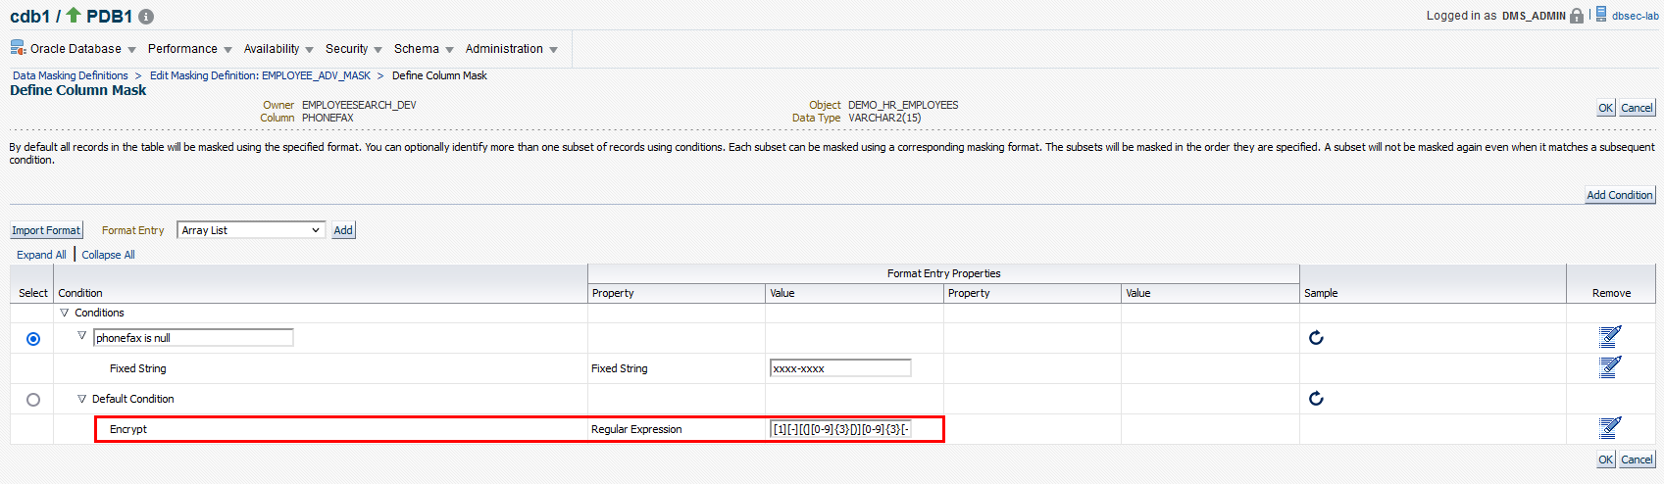
Oracle Data Masking and Subsetting
Advanced Options - Key-Based reversible Masking - Encrypt
Transforms the original data into a masked representation of itself using a secure key-based reversible masking function.
Once the data is recovered from the 3rd party, the business can recover the original data by reversing the masking using the same key.
Notes:
Deterministic Encryption encrypts column data using a cryptographic key and Advanced Encryption Standard (AES 128), hashing, and regular expression to produce a deterministic masked output. The format of the masked output corresponds to the specified regular expression.
As this technique uses a key to encrypt the data, the same string can be used to decrypt the data.
The key also acts as seed to maintain consistent outputs for a given input.
It supports format preserving encryption, i.e., the format of column data is preserved after encryption.
It’s a deterministic and reversible masking format. It is helpful when businesses need to mask and send their data to a third party for analysis, reporting, or any other business processing purpose. After the processed data is received from the third party, the original data can be recovered (decrypted) using the same seed value that was used to encrypt the data.
Caution, this method is therefore not compatible with strict regulations such as EU GDPR

Slide 52
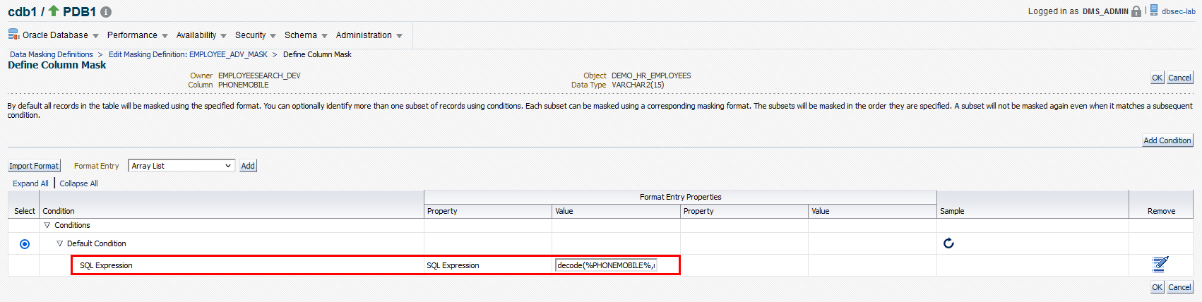
Oracle Data Masking and Subsetting
Advanced Options - Deterministic Masking (SQL Expression – ORA_HASH)
Leverage versatility of SQL Expression
Accommodates complex masking logic
Achieve consistency across databases
Overcome application defined relationships (User Defined Function / SQL Expression using ORA_HASH)
decode(%PHONEMOBILE%,null,'N/A',ORA_HASH (%PHONEMOBILE%, 9) || '-(‘ || ORA_HASH (%PHONEMOBILE%, 999) || ')' || ORA_HASH (%PHONEMOBILE%, 999) || '-' || ORA_HASH (%PHONEMOBILE%, 9999)
Notes:
SQL Expression lets you use a SQL expression to mask column data.
Data Masking uses the specified SQL expression to generate values which are used to replace the original data.
It can also contain substitution columns (columns from the same table as the column to be masked).
You should specify the substitution columns within percent (%) symbols.
You can also use ORA_HASH function in order to have a deterministic value.
ORA_HASH takes three arguments: 1. Expression
2. Number of hash buckets
3. Seed, can be any number which decides the consistency
The uniqueness is not guaranteed but depends on the input and the number of hash buckets used.
https://blogs.oracle.com/datamasking/entry/deterministic_consistent_unique_masking

Slide 53
Demo
Advanced Features

Slide 54
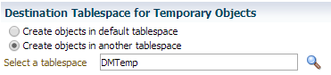
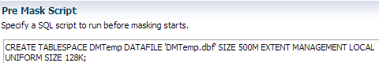
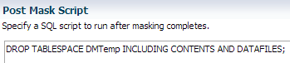
Oracle Data Masking and Subsetting
Pre and Post-Scripting options
Example: Avoid space issues in User Tablespace
Use “temporary tablespace” option inside masking definition to store temporary objects created by data masking
Create the temporary tablespace as part of pre masking script
Drop the tablespace as part of post masking script

Slide 55
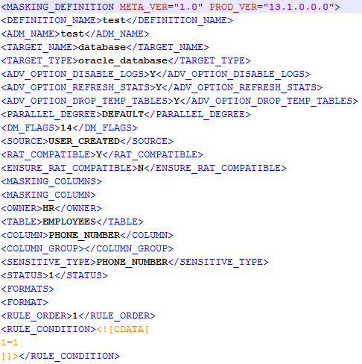
Oracle DMS Demo Tips
Leverage Advanced Options
Best Practices for Bulk Changes
Use backend XML files while dealing with several objects and multiple modifications
Export ADM/Masking/Subsetting definition to XML file
Use XML editor to make the necessary changes
Import the modified XML files into EM

Slide 56
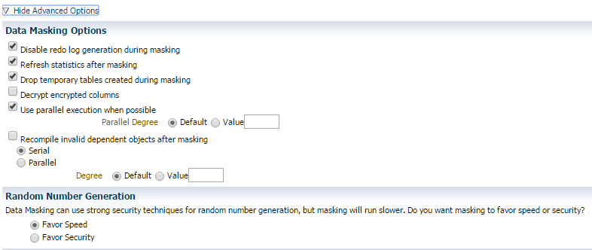
Oracle DMS Demo Tips
For Performance Improvements
Disable redo log generation
Disable refresh statistics after masking
Override default parallel degree

Slide 57
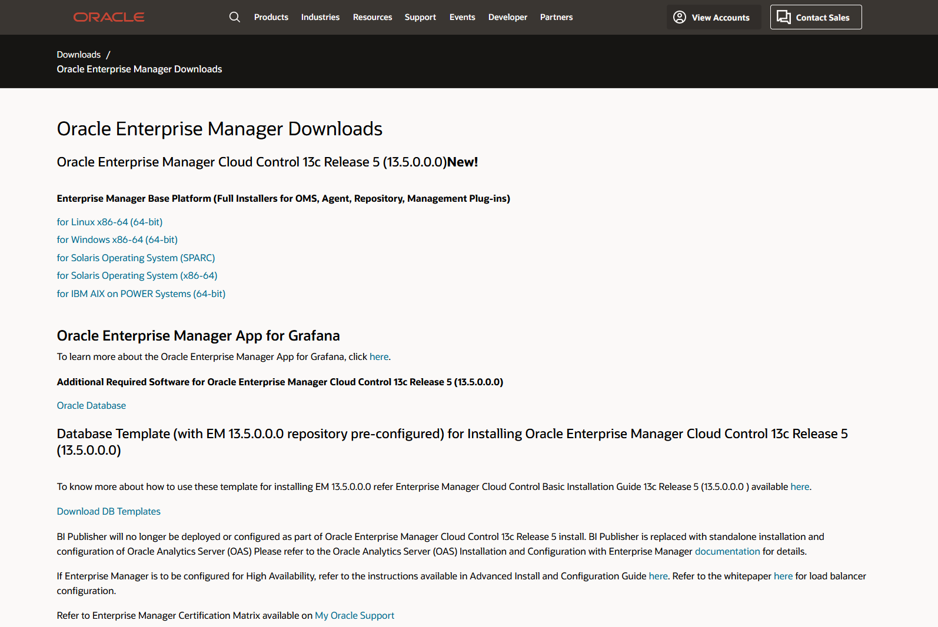
Oracle Data Masking and Subsetting
Enterprise Manager - Optimization and Usability Improvements
30% optimized storage
Down to 3.25 GB from 5GB masking a 2GB table in HR schema
40% improved performance
In-Export masking time of 52 GB of data is down to 20 min from 30 min
Export/import full database during In-Export operation

Slide 58

Static Data Masking solutions
Oracle Data Safe: Cloud Services
Assess
Users
Audit
Discover
Mask
Firewall
Oracle Data Safe comprises six components in a single integrated service and delivers this to any Oracle Database user
Security Assessment
User
Assessment
Activity Auditing
Data
Discovery
Data Masking
SQL Firewall

Slide 59







Oracle Data Safe
Sensitive Data Discovery: 125+ Pre-defined Sensitive Types
Identification | Biographic | IT | Financial | Healthcare | Employment | Academic
SSN Name Email Phone Passport DL Tax ID … | Age Gender Race Citizenship Address Family Data Date of Birth Place of Birth … | IP Address User ID Password Hostname GPS location … | Credit Card CC Security PIN Bank Name Bank Account IBAN Swift Code … | Provider Insurance Height Blood Type Disability Pregnancy Test Results ICD Code … | Employee ID Job Title Department Hire Date Income Stock … | College Name Grade Student ID Financial Aid Admission Date Graduation Date Attendance …

Slide 60
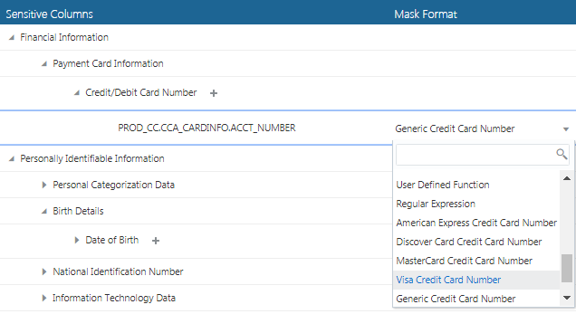
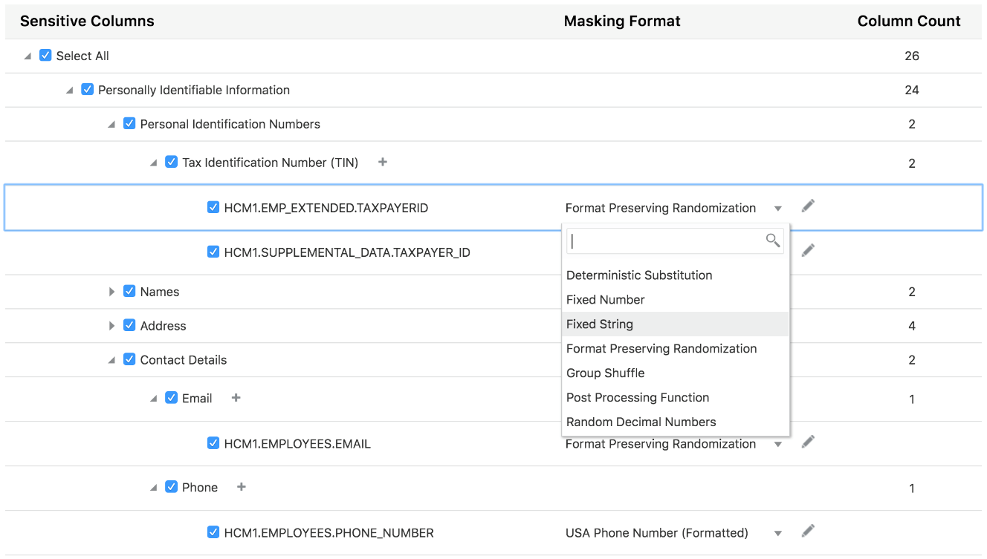
Oracle Data Safe
Sensitive Data Masking
Minimize sensitive data exposure for dev & test, partners, analytics databases
Preserves application integrity
Mask data identified as sensitive
50+ predefined masking formats
Automated format selection based upon sensitive type
Optional user-defined masking formats
Rich masking transformations for complex cases
Conditional, Compound, Deterministic, …
Masking reports
What and how much data was masked
Notes:
Random, Deterministic
Shuffle
Conditional
Compound
Reversible
SQL expression based
User-defined

Slide 61
Oracle Data Masking and Subsetting (DMS) vs Data Safe
Capabilities | Data Safe | DMS
Sensitive data discovery | Yes | Yes
Incremental discovery option | Yes | -
Default masking formats based on sensitive data type | Yes | -
In-place data masking | Yes | Yes
In-export masking | - | Yes
Data subsetting | - | Yes
On-premises Oracle databases | Yes | Yes
Multi-Cloud Oracle databases | Yes | -
Oracle Real Application Testing (RAT) masking | - | Yes
Support for non-Oracle databases | - | Yes*
* Requires use of transparent gateways (license included) or ODI

Slide 62
Licensing

Slide 63
Oracle Data Masking and Subsetting
Licensing terminology
SOURCE
Database from which the data originates
In general a production database
In multi-source environment all production databases
In Oracle Data Guard both primary and standby servers
STAGING
TARGET
Database on which masking and subsetting operations are performed
DB to which masked and subsetted data is copied from staging DB without natively performing the masking and subsetting operations

Slide 64




Oracle Data Masking and Subsetting
Licensing
In-Database
In-Export
Mask/Subset
Mask/Subset
Clone
Dev
Import
Dev
Source
Clone
Source
Export
Staging
Dump Files
Test
Test
Mask/Subset
Licensing changed in 2017:
Staging server CPUs no longer counted (only source CPUs)
CPU based pricing | USD 11,500 USD 2,530 (SW Update license & Support)
NUP based pricing | USD 230 USD 50.60 (SW Update license & Support)
Min NUPs per CPU | 25
Licensed Servers
Mask/Subset
Dev
Clone
Source
Test
Notes:
In-Database Masking and Subsetting :
In general In-Database masking and subsetting is performed in a staging Oracle Database EE which contains cloned data from production database(Oracle Database EE). Masked and subsetted data can be further cloned to multiple dev and test databases(can be Oracle Database EE or SE). In this case users must license both source(production) and staging(non-production) servers.
Some DBA teams do not have the concept of intermediate staging database, instead they wish to perform masking and subsetting directly on multiple Dev and Test databases. In this case users must license source(production) and multiple dev and test servers.
In-Export Masking and Subsetting:
In general In-Export masking is perform on production data. In-Export method extracts the data from source database and dumps it to Oracle data pump export files. It masks and subsets the data during extraction process.
As there is no separate staging or test or dev database involved in this process , users will end licensing only the source/ production database (Oracle Database EE). If users choose to perform In-Export masking in a staging database instead of production then they must license both source and staging servers.
In Oracle Data Guard setup, do I need to include standby or recovery server in Oracle Data Masking and Subsetting license?
According to Oracle licensing policy, in Oracle Data Guard configuration, the number of licenses in a primary and standby server must match. So you must license Oracle Data Masking and Subsetting pack for both primary and standby servers.

Slide 65
Oracle Data Masking and Subsetting
Licensing for Masking Non-Oracle Databases
Includes Restricted Usage License for:
Database Gateway APPC
Database Gateway DRDA
Database Gateway for Informix
Database Gateway for SQL Server
Database Gateway for Sybase
Database Gateway for Teradata
Guidance: Use with caution
DB Gateways are unstable and underperforming
You have to code everything manually
Lots of data types restrictions
Oracle Gateway for MSSQL can't pull tables with LONG data types
Oracle Gateway for Informix, issues with mapping
Mask/Subset
Non-Oracle Source
Load
Load
Oracle Staging
Target
Licensing changed in 2017:
Staging server CPUs no longer counted (only source CPUs)
CPU based pricing | USD 11,500 USD 2,530 (SW Update license & Support)
NUP based pricing | USD 230 USD 50.60 (SW Update license & Support)
Min NUPs per CPU | 25
Licensed Servers
Separate Oracle DB EE License
Notes:
Starting June 2016, there is no separate price list item called Oracle Data Masking and Subsetting pack for non-Oracle Databases. Its capabilities are merged into the existing Oracle Data Masking and Subsetting pack.
Heterogeneous Masking and Susbetting
When using the Oracle Data Masking and Subsetting Pack for non-Oracle databases, the Oracle Database Gateways stage the data in a separately licensed Oracle Database EE. Oracle Data Masking and Subsetting functionality cannot be executed directly against the non-Oracle database. In this cases users must license non-Oracle source and the staging Oracle Database EE.

Slide 66
Positioning, competition and objections
Strengths and weaknesses

Slide 67

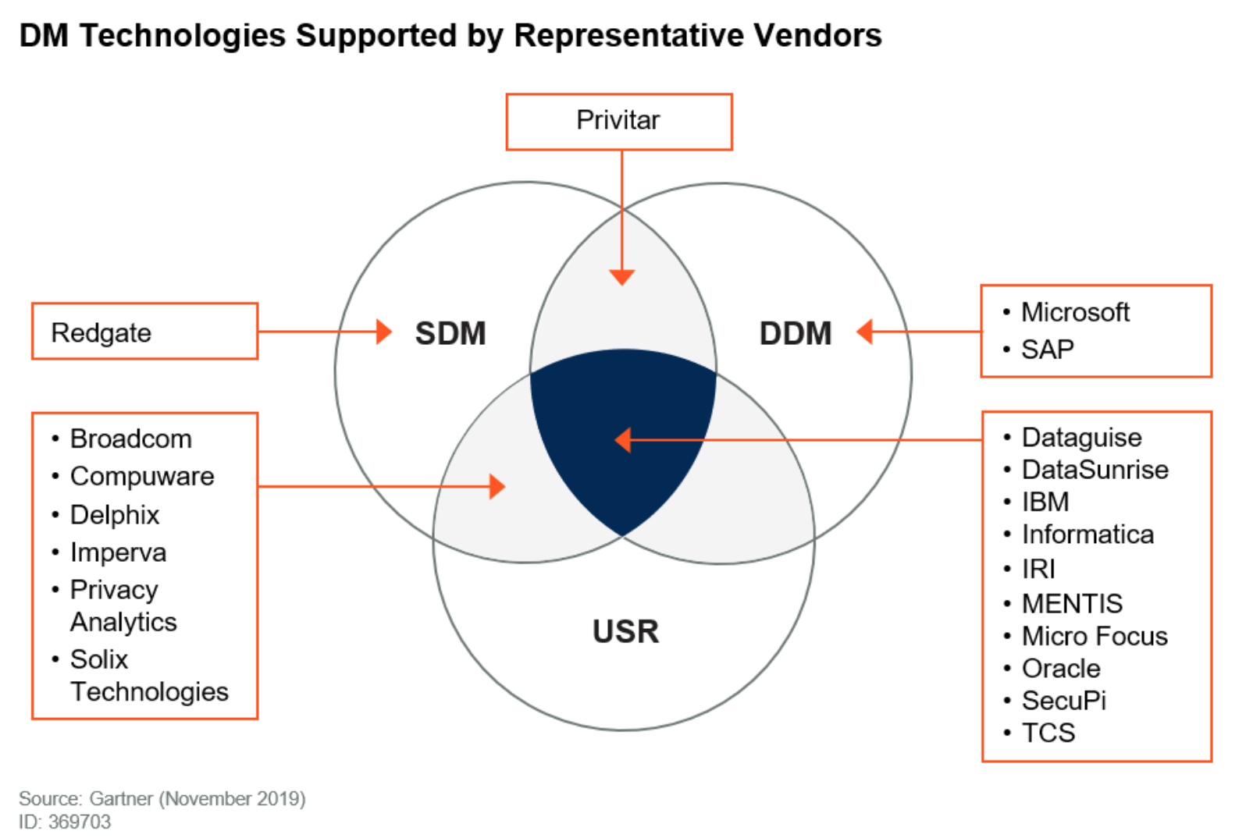
Data Masking
Landscape vendors
Static Data Masking
Dynamic Data Masking
Unstructured/Semi-structured Redaction

Slide 68









Oracle Data Masking and Subsetting
Competitive Landscape
Database Vendors
Security and Data Suites
Niche Players
DataMasker.com

Slide 69
Oracle Data Masking and Subsetting
High-Level Comparison
 | Oracle | Competition
In-Database Vendors Informatica Imperva | Integrated solution offers lower Total Cost of Ownership. | Typically require heavy services engagements.
 | Superior performance on Oracle databases. | Database independent architecture typically produces slow, unproven performance.
 | Unified web-based interface enables masking across all databases on-premises and in the cloud. | Separate masking interfaces customized for each packaged application. e.g., Siebel, SAP, PeopleSoft
ETL Vendors IBM Informatica CA Broadcom | With Oracle in-export masking, data is masked and subsetted during on-the-fly extraction maintaining protection of sensitive information. | Sensitive data is sanitized after extraction, exposing sensitive data to attacks and adding in-scope data sets for compliance audits.
 | Integration with Oracle Data Pump technology enables higher extraction and load rates. And transformation happens during extraction. | Traditional methods of data extraction (e.g. to flat files) results in a slower performance.
 | Browser-based interface allows rapid adoption with minimal training. | Complex design tool requires installation & training, and delays time to value.
For more details, please check the Data Masking Compete Guide

Slide 70

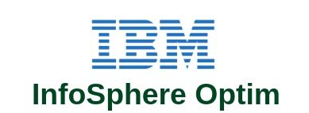

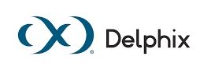
Oracle Data Masking and Subsetting
Serious competitors
Hard to be efficient
Hard to be accurate
Slow performance
Hard to integrate
Integration issues
No hybrid cloud story
Very expensive
Weak security portfolio
Weak user community
No hybrid cloud story
Data Virtualization only
Limited masking
Confusing UI
Hard to scale
Hard to maintain
Staffing issues
Slow performance on Oracle DBs
High learning curve
Expensive
No Subsetting
High learning curve
Weak portfolio
No subsetting
Weak user community
Notes:
Our biggest competitor, by far, is the fact that companies make their own masking scripts.
However, what seems like a good idea for them at first, quickly becomes a headache as the database evolves, becomes more complex or changes the team managing it... and very quickly, the scripts become obsolete, very difficult to maintain and therefore unusable!
The 2nd and 3rd major competitors are IBM (with Infosphere Optim solution) and Informatica.
Both are serious competitors because they have teams as good as those we have at Oracle.
However, both encounter the same difficulties compare to us, namely, high cost, significant complexity in implementing their solution due to a complex architecture to deploy, they don’t have a real efficient Subsetting features as ours and a high learning curve which further increases the final bill by adding a significant operating cost.
Finally, Delphix can sometimes appear as a competitor, but the fact that it only focuses on the virtualization means it's a very unrepresentative niche actor.
More informations:
In-House Solution
Hard to be efficient: discovering thousands of sensitive columns and relationships; masking; subsetting
Hard to be accurate: SSNs, AMEX, VISA, Discover, Master, and more
Slow performance: Time taken to manually update/delete thousands of columns
Hard to scale: Generating a repeatable process across several databases
Hard to maintain: Updating scripts as the application and data evolves
Staffing issues: Having resources to develop, maintain, and support
Hard to integrate: With other security, testing, and data integration features
IBM Infosphere Optim
Expensive: Sells every component separately (even templates)
Slow performance on Oracle DBs: due to the ETL process via JDBC connection
High learning curve due to different architectures and interfaces
Integration issues: between their own and 3rd party products (security, testing, and data integration )
No hybrid cloud story
Informatica Persistent Data Masking
Very expensive: Sells every component separately (even templates)
Weak security portfolio: No Subsetting, no encryption, DB Vault, AVDF like solutions
High learning curve due to different architectures and interfaces
Weak user community: too few users are familiar with their products
No hybrid cloud story
Delphix
Masks over Data Virtualization only: functionality through Snap Clone technology
Limited masking: Axis acquisition brought only limited masking features
Weak portfolio: No subsetting, no app templates, no other security offerings, no performance tuning products, no cloud story, and more …
Confusing UI: Look and feel of Delphix native toolset is different from Axis masking UI
Weak user community, customer support, and implementation experts

Slide 71
Oracle Data Masking and Subsetting
Key positioning and talking points
Total Cost of Ownership
Discover, subset, and mask using a familiar tool (Enterprise Manager) via a single license
Simple to deploy and easy-to-use centralized and unified masking and subsetting
In-export masking minimizes requirements for security at a staging area
Tight integration across Oracle Database ecosystem
Supports heterogeneous masking across non-Oracle databases via Database Gateways and ODI
High Performance
Fast, full-database masking on Oracle Database
Leverages several Oracle Database internal kernel features for optimal performance
In-Export execution leverages proven Oracle Data Pump technology
Flexibility
Comprehensive, extensible, and flexible masking options to meet diverse requirements
Flexible options for data subsetting enable right-sized data sets for non-production
Flexible deployment options (in-database and in-export)

Slide 72
Oracle Data Masking and Subsetting
Key positioning and talking points
Robust Data Discovery
Examines both metadata and actual data to discover sensitive columns which helps minimize false positives and false negatives
Discovers dictionary-based referential relationships and also provides the option to auto-discover application-level relationships. It helps preserve data integrity during masking and subsetting
Application Templates
Offers masking templates for Oracle EBS and Fusion Apps, certified by the application teams
Templates are available at no additional cost and dramatically reduce effort and time-to-value which ultimately reduces total cost of ownership
Defense-in-Depth
Masking is one layer in Oracle’s extensive strategy for holistic database security
Oracle is a single vendor you can trust for unified database management and security

Slide 73
Oracle Data Masking and Subsetting
Key Benefits
One license
Discovery, Masking, Subsetting, Templates, and Gateways bundled into single license
High performance on Oracle DBs
Leverages several Oracle Database internal kernel features
In-Export execution leverages proven Oracle Data Pump technology
Key feature
Subsetting
Secure
Hybrid cloud management
Centralized and unified management
Integration with Oracle Eco System
Mask during clones, snap clones, PDB clones to cloud, RAT, ODI, encryption, compression, EBS, templates …
Strategic
Comprehensive defense-in-depth and compliance strategies
In-Export masking and subsetting
Sensitive data is sanitized on-the-fly while extracting the data from database

Slide 74
Doing A Successful Proof of Concept

Slide 75
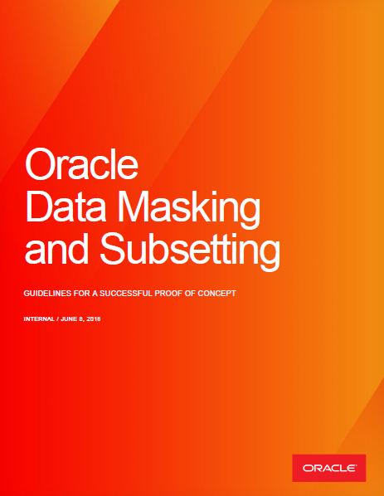
Oracle Data Masking and Subsetting
Doing a successful Proof of Concept
Before the PoC
Be well-prepared and comfortable with DMS – read docs, do exercises, clarify doubts using slack and distribution lists
Ensure that the PoC specifications and KPIs are clear and well-defined
Ensure that you have the right people (analyst, application architect, IT) and the right resources (good hardware, storage, network bandwidth, ports opened) on the client side
Check for unsupported objects
Careful about the web browser you are using (version, known issues, slowness)
Guidelines for a Successful PoC
DMS - Guidelines for a Successful PoC

Slide 76
Oracle Data Masking and Subsetting
Doing a successful Proof of Concept
Install the latest version of Enterprise Manager and deploy the right agents
First demonstrate to the customer that DMS does the right thing and meets the requirements before worrying about performance
Ensure that you have a way to “restore” the database
Make use of command line (EMCLI) to automate/speed up the process
In case of trouble, check the Troubleshooting and Frequent Problems sections
Guidelines for a Successful PoC
DMS - Guidelines for a Successful PoC

Slide 77
Oracle Data Masking and Subsetting
Doing a successful Proof of Concept
In case of defects:
Open an SR as soon as possible and send an email to the PM team sharing the SR details
Meanwhile, switch to other tasks if possible and never waste time in front of customer
After the PoC
Provide feedback to the PM team – problems encountered, defects, enhancements requests, competition details (weaknesses and strengths)
Guidelines for a Successful PoC
DMS - Guidelines for a Successful PoC

Slide 78
Go Further

Slide 79
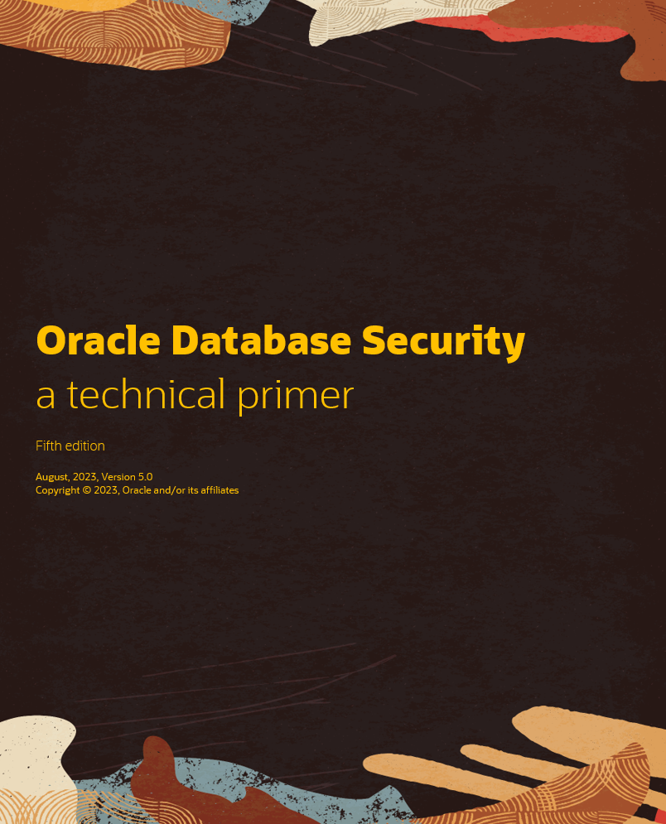

Updated Database Security eBook
The fifth edition of our database security primer includes:
Managing SQL Injection risk with Database 23c’s SQL Firewall
Latest updates for Data Safe
Database security posture management with Audit Vault and Database Firewall
Preparing your databases for ransomware attacks
Removing security and regulatory risk from test and development databases
And much more!

Slide 80



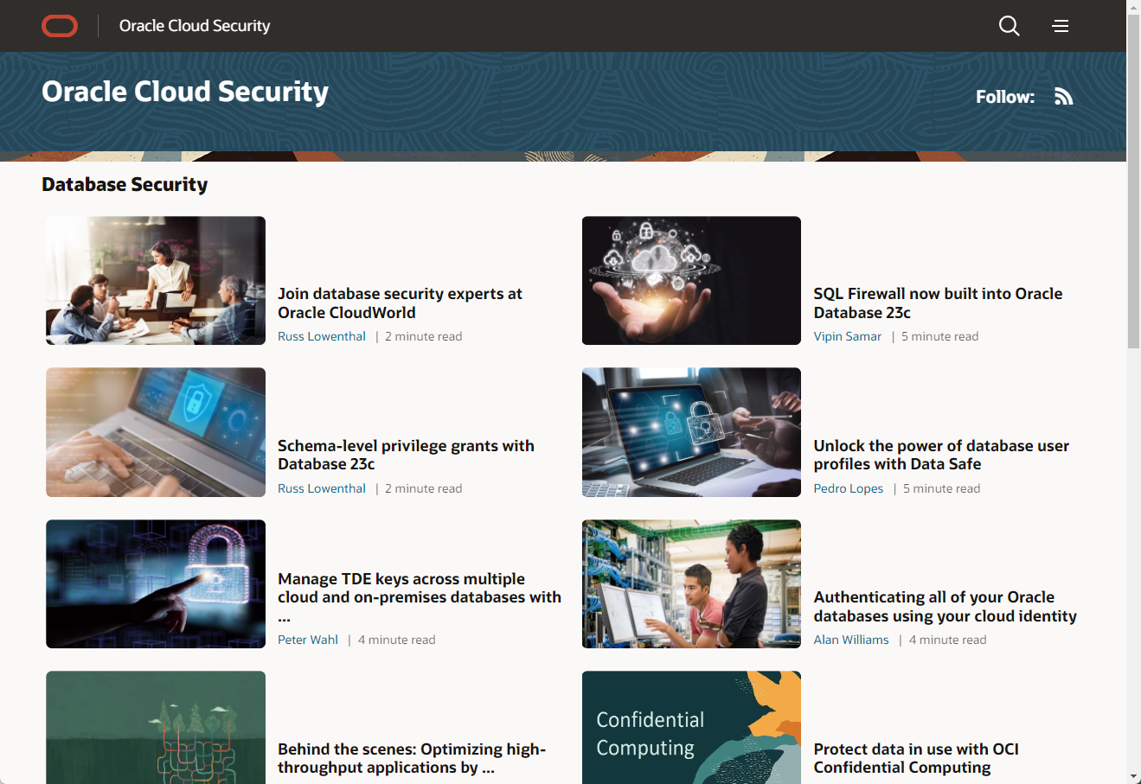





Helping you keep up
Monthly office hours
Second Wednesday of each month at
10:00 am US Central
Database security blog
Documentation and support notes
Oracle LiveLabs – your database security playground
Notes:
We’re also investing in keeping you up to date and informed. From our monthly office hours (second Wednesday of each month) to self-service hands on training with Oracle Live Labs to a comprehensive review of MOS notes and our documentation,

Slide 81
Thank you

